Slide 1


US College Data Analysis (for Parents)
Sheetal Gangakhedkar
June 8, 2017
Class: Introduction to Data Analysis, 30211.(013)
Instructor: Pramod Gupta
Data Source: US Department of Education: College Scorecard Data

Slide 2

Motivation
My daughter is in 11th grade, this is her big decisions year. She is in the process of deciding the US colleges to apply based on her interests, her grades and her SAT score. My goal is to shortlist colleges that fit her profile and also bring her awareness of US Undergraduate Schools.
Notes:
2

Slide 3
Objectives
I am hoping to analyze this US College Scorecard data to find the US Universities she should consider for her undergraduate study, taking into consideration the in-state and out-of-state tution costs, acceptance rate, available BS degrees, size of the university, graduation rate, number of full-time professors, number of students enrolled, possibility of getting some scholarship.
Notes:
3

Slide 4

Data Source
US Department of Education: College Scorecard Data
https://collegescorecard.ed.gov/data/
Here, you can get the data behind the College Scorecard, as well as other data on federal financial aid and earnings information. These data provide insights into the performance of schools eligible to receive federal financial aid, and offer a look at the outcomes of students at those schools.
Notes:
4

Slide 5
Data Collection
college=read.csv2("./CollegeScorecard_Raw_Data/MERGED2014_15_PP.csv",
header = TRUE,
sep = ",",
colClasses = NA,
skip = 0,
dec = ".",
strip.white = TRUE,
na.strings = "NULL",
skipNul = TRUE,
numerals = c("allow.loss"),
stringsAsFactors = FALSE
)
dim(college)
ISSUES: Import into proper types, suppress factors, floats imported as char strings
Notes:
5

Slide 6
Data Cleaning
Starting Point: rows=7703, cols=1743
Remove duplicate college observations college[!duplicated(college[,"OPEID6"]),]
Replace PrivacyReplaced, NULL strings with NA. college[sapply(college, function(x) (x == "PrivacySuppressed"))] = NA
Choose colleges that are currently operating college[(college[,"CURROPER"]==1),]
Remove columns not relevant for 4yr undergraduate degree programs (2yr, cert, associate) college[,!grepl("CIP\\d+ASSOC|CIP\\d+CERT\\d", colnames(college))]
Remove columns relating to income levels, debt repayments, college[,!grepl("NPT\\d", colnames(college))]
Remove colleges that don't offer 4yr undergraduate degree programs college[(college[,"ICLEVEL"]==1),]
Notes:
6

Slide 7
Data Cleaning continued…
Remove colleges with no accreditation college[(!is.na(college[,"ACCREDAGENCY"])),]
Choose colleges that offer only 4yr undergraduate degree programs, highest degree, Carnegie classification. college[(!is.na(college[,"ACCREDAGENCY"])),]
Remove schools with religious affiliation, and distance only education college[(college[,"RELAFFIL"]<22),], college[(college[,"DISTANCEONLY"]==0),]
Remove columns relating to percent of degrees awarded , and many misc columns.
End Point: rows=1285, cols=192
Notes:
7

Slide 8

Analyzing Data
1. Top 20 most competitive US colleges, with high student population but with low admissions rate (with barplot)
INSTNM ADM_RATE_ALL SAT_AVG UGDS
3344 University of Pennsylvania 0.1036636 1452 10678
2417 Cornell University 0.1418547 1422 14195
244 University of California-Berkeley 0.1602017 1382 27126
537 University of Southern California 0.1802388 1380 18392
247 University of California-Los Angeles 0.1855738 1330 29627
2. Top 20 most accepting US colleges, with high student population and high admissions rate (with barplot)
INSTNM ADM_RATE
3803 The University of Texas at El Paso 0.9989
3859 Utah State University 0.9783
2822 University of Akron Main Campus 0.9571
1393 Wichita State University 0.9553
Notes:
8

Slide 9
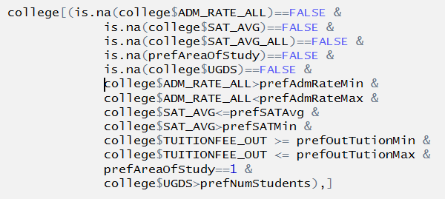
Analyzing Data
3. Given a Student profile, find 20 US colleges that are competitive (admission rate, SAT score, Out-of-state Tuition Fees, Area of Study/Degree, school size by student population) and to be considered as a shortlist for applying.
[1] "California Polytechnic State University-San Luis Obispo"
[2] "University of California-Berkeley"
[3] "University of California-Davis"
[4] "University of California-Los Angeles"
[5] "University of California-San Diego"
[6] "University of California-Santa Barbara"
[7] "University of Connecticut"
[8] "University of Miami"
[9] "Georgia Institute of Technology-Main Campus"
[10] "University of Maryland-College Park"
[11] "Northeastern University"
[12] "University of Michigan-Ann Arbor"
[13] "University of Minnesota-Twin Cities"
[14] "SUNY at Binghamton"
[15] "Stony Brook University"
[16] "University of North Carolina at Chapel Hill"
[17] "North Carolina State University at Raleigh"
[18] "Clemson University"
[19] "The University of Texas at Austin"
[20] "University of Virginia-Main Campus"
Notes:
9

Slide 10
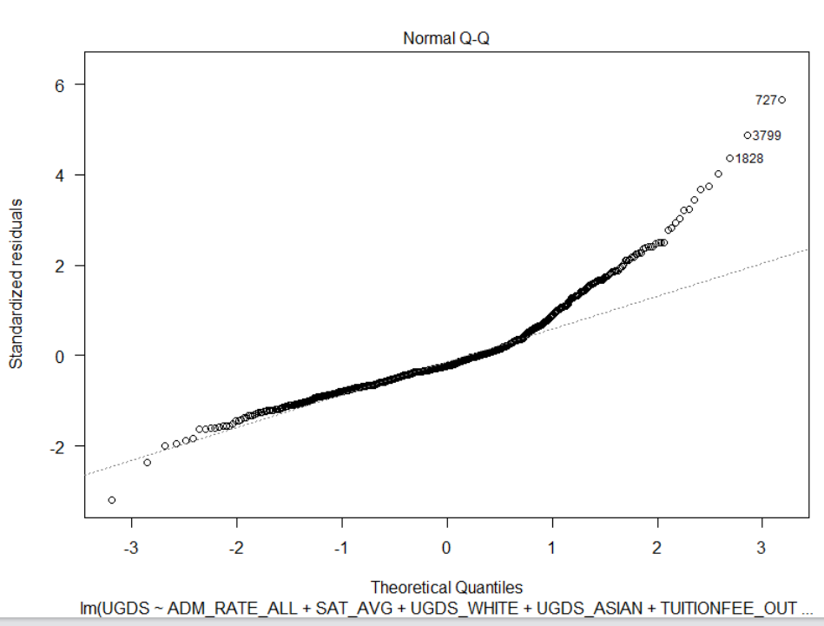
Linear Regression & Visualization
Explore relationship between number of enrolled students with admission rates, SAT, key race proportions, tuition fees.
lm(formula = UGDS ~ ADM_RATE_ALL + SAT_AVG + UGDS_WHITE + UGDS_ASIAN +
TUITIONFEE_OUT, data = college)
Residuals:
Min 1Q Median 3Q Max
-23079 -4671 -1721 2528 41791
Coefficients:
Estimate Std. Error t value Pr(>|t|)
(Intercept) -1.649e+04 3.446e+03 -4.785 2.09e-06 ***
ADM_RATE_ALL 8.238e+03 1.815e+03 4.540 6.64e-06 ***
SAT_AVG 2.516e+01 3.442e+00 7.308 7.46e-13 ***
UGDS_WHITE -2.650e+03 1.620e+03 -1.636 0.102
UGDS_ASIAN 3.698e+04 5.380e+03 6.873 1.40e-11 ***
TUITIONFEE_OUT -3.347e-01 3.808e-02 -8.789 < 2e-16 ***
---
Signif. codes: 0 ‘***’ 0.001 ‘**’ 0.01 ‘*’ 0.05 ‘.’ 0.1 ‘ ’ 1
Residual standard error: 7393 on 693 degrees of freedom
(586 observations deleted due to missingness)
Multiple R-squared: 0.2053, Adjusted R-squared: 0.1995
F-statistic: 35.8 on 5 and 693 DF, p-value: < 2.2e-16
Notes:
10

Slide 11
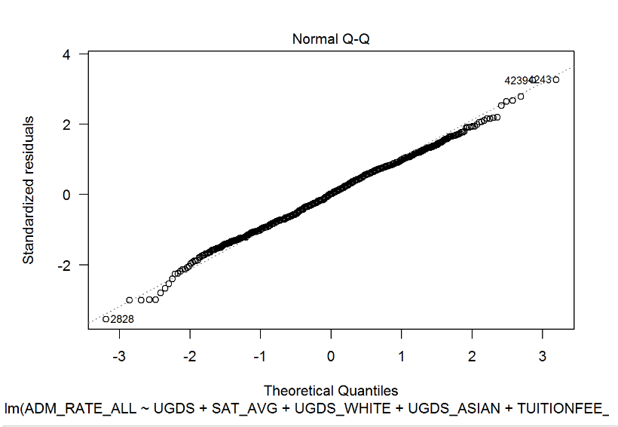
Linear Regression & Visualization
Explore relationship between admission rates with number of enrolled, SAT, key race proportions, tuition fees.
lm(formula = ADM_RATE_ALL ~ UGDS + SAT_AVG + UGDS_WHITE + UGDS_ASIAN +
TUITIONFEE_OUT, data = college)
Residuals:
Min 1Q Median 3Q Max
-0.5387 -0.1080 0.0030 0.1093 0.4871
Coefficients:
Estimate Std. Error t value Pr(>|t|)
(Intercept) 1.298e+00 5.282e-02 24.575 < 2e-16 ***
UGDS 3.506e-06 7.723e-07 4.540 6.64e-06 ***
SAT_AVG -8.480e-04 6.628e-05 -12.794 < 2e-16 ***
UGDS_WHITE 3.798e-01 3.021e-02 12.570 < 2e-16 ***
UGDS_ASIAN -4.473e-02 1.147e-01 -0.390 0.697
TUITIONFEE_OUT 1.745e-07 8.283e-07 0.211 0.833
---
Signif. codes: 0 ‘***’ 0.001 ‘**’ 0.01 ‘*’ 0.05 ‘.’ 0.1 ‘ ’ 1
Residual standard error: 0.1525 on 693 degrees of freedom
(586 observations deleted due to missingness)
Multiple R-squared: 0.4542, Adjusted R-squared: 0.4502
F-statistic: 115.3 on 5 and 693 DF, p-value: < 2.2e-16
Notes:
Residuals statistics
1Q, Mean, 3Q: The residuals have a nice, bell-shaped distribution
Are the coefficients significant? (significant features)
p-value is the probability that gauges the likelihood that a coefficient is not significant, so smaller is better.
Is the model useful? (R2 - coefficient of determination))
R2 is a measure of the model’s quality. Bigger is better (0.452)
In this case, the model explains 0.452 (45.2%) of the variance of ‘ADM_RATE_ALL’, and the remaining 0.548 (54.8%) is unexplained.
Is the model statistically significant? (F Statistic)
Conventionally, a p-value of less than 0.05 indicates that the model is likely significant p-value<2.2e-16
11

Slide 12
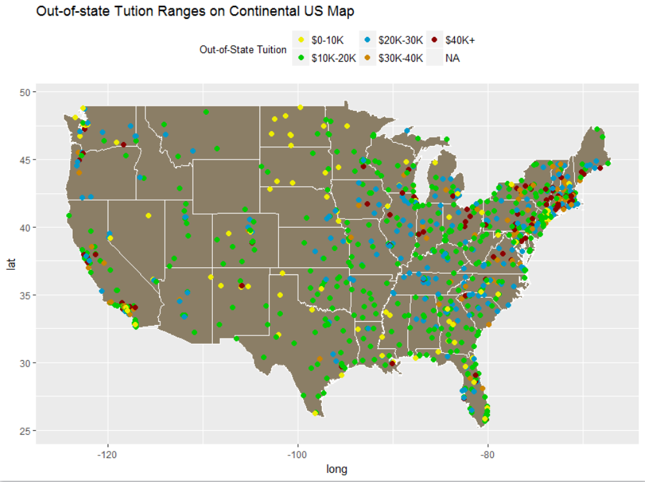
Data Visualization
Plot on Continental US Map out-of-state tuition costs
tuitionColors <- c("yellow2", "green3", "deepskyblue3", "orange3", "red4")
names(tuitionColors) <- levels(schools$tuition)
tutionMap <- NULL
tutionMap <- ggplot(schools)
tutionMap <- tutionMap + borders("state", colour="white", fill="wheat4")
tutionMap <- tutionMap + geom_point(mapping=aes(x=LONGITUDE, y=LATITUDE,
colour=tuition), size=2)
tutionMap <- tutionMap + ggtitle("Out-of-state Tution Ranges on Continental US Map")
tutionMap <- tutionMap + scale_colour_manual(name = "Out-of-State Tuition",values = tuitionColors)
tutionMap <- tutionMap + theme(legend.position="top", legend.box="horizontal",
legend.text=element_text(size=10),
legend.title=element_text(size=10))
Notes:
12

Slide 13
Summary
Understanding and Cleaning of raw data is essential for analysis.
Larger student populations correlates well with the school ranking.
Admission rates are lower for better, larger schools.
Visualization shows tuitions fees are higher in schools along East and West coasts.
Strong relationship between admission rates with number of enrolled, SAT, key race proportions.
Reference: https://images.google.com

